Slide 1
SECTION1&2: Reduction & Scan
SECTION3: Atomic
SECTION4: Spase Matrix Expression
Section5: Gpu&PC Arch
Section6: TC & Stream
Sec7&8

Slide 2
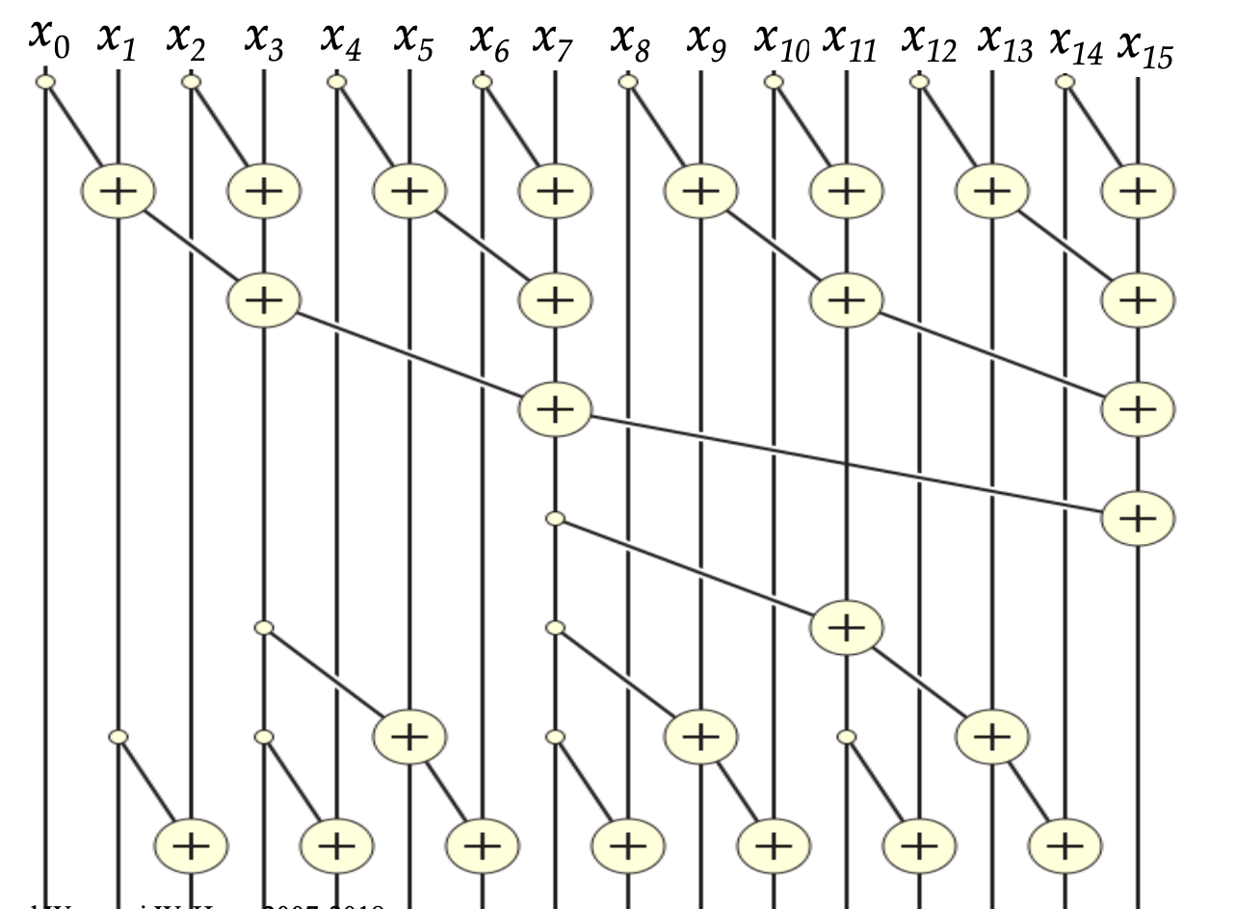
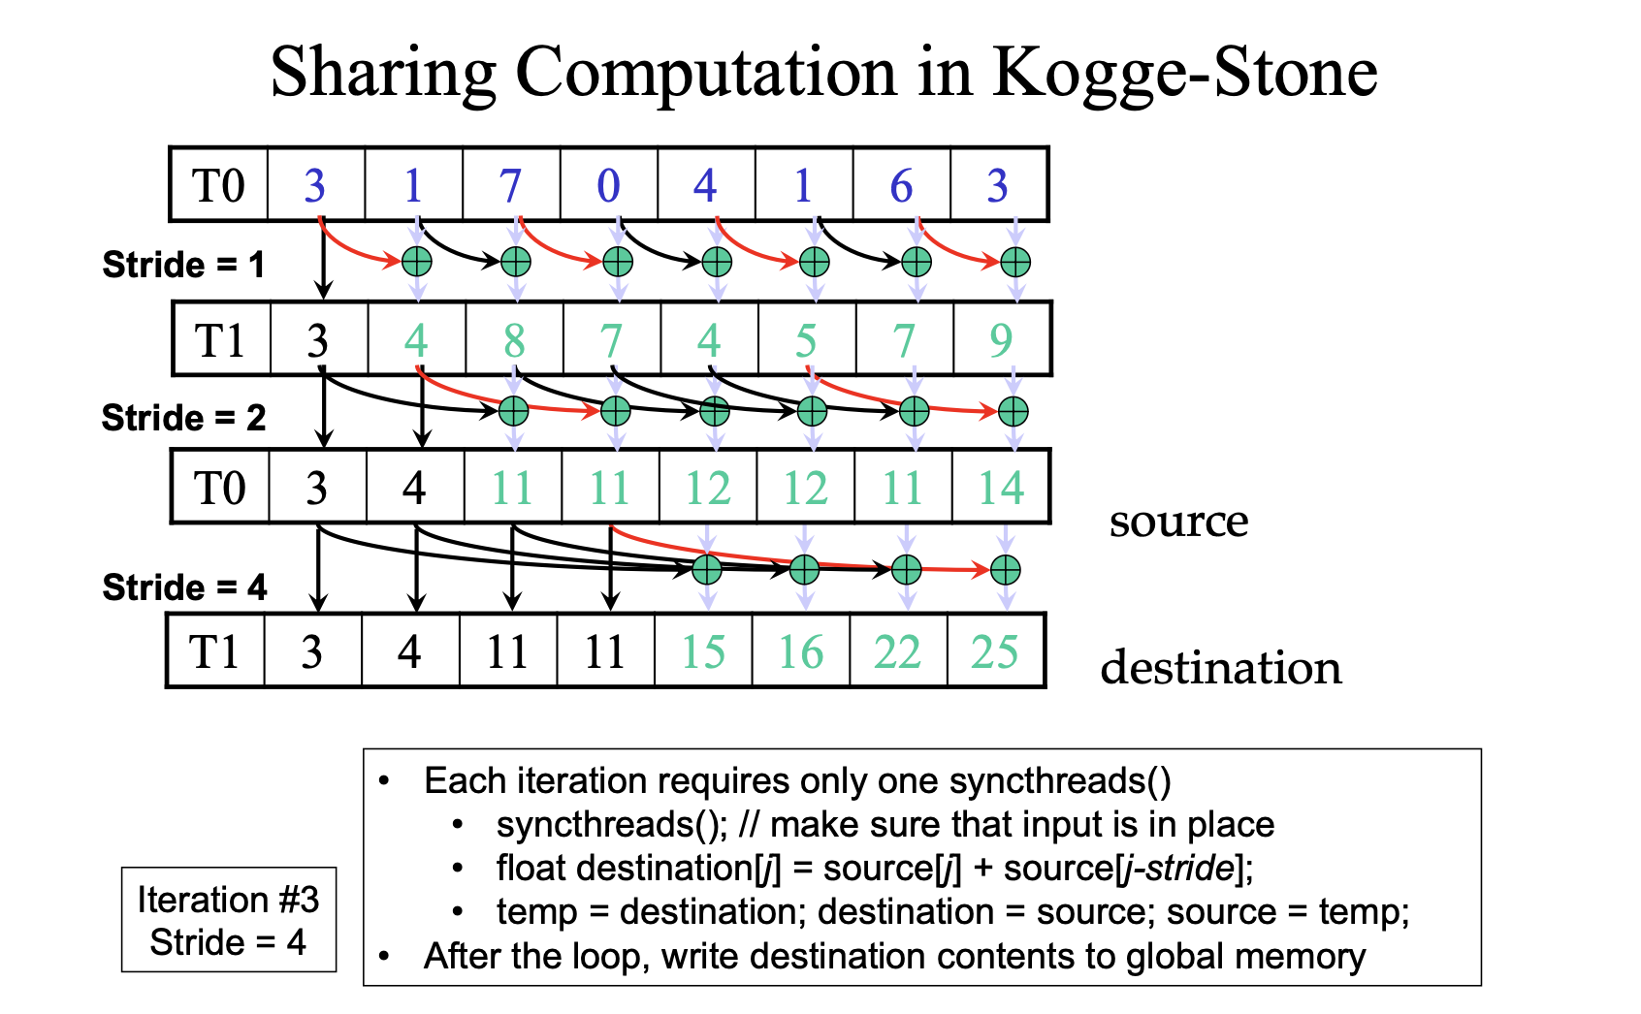
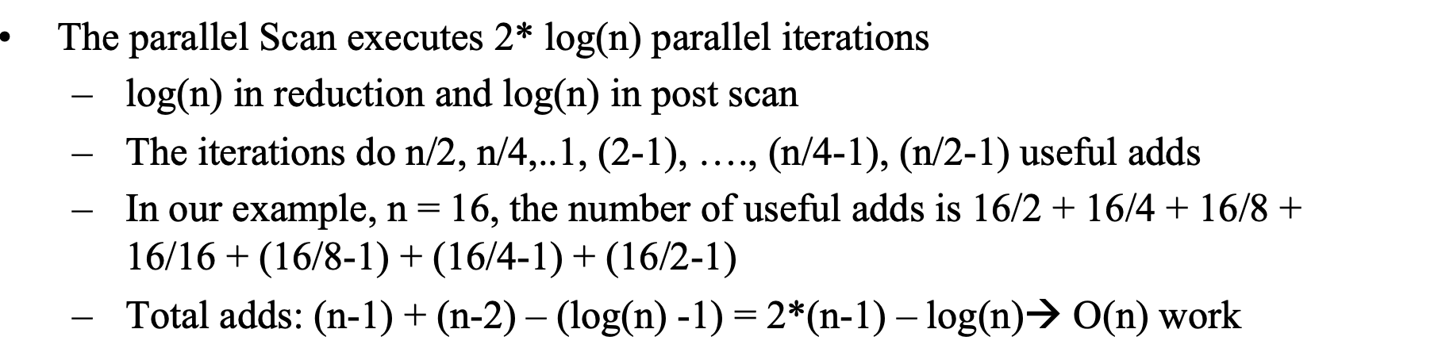
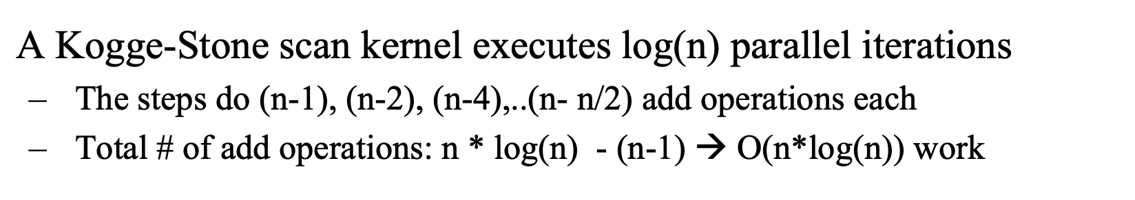
SECTION1&2: Reduction & Scan
For Reduction: 2019 Guide, Q1
For Scan: Method1—KS & BK method, Q2
What is the best combination?
KS vs. BK
From number of operation....
From steps & threads....

Slide 3
SECTION3: Atomic
The use of privatization to increase efficiency
For most calculation questions, don't think too much... (Questions in quide)

Slide 4
SECTION4: Spase Matrix Expression

Slide 5
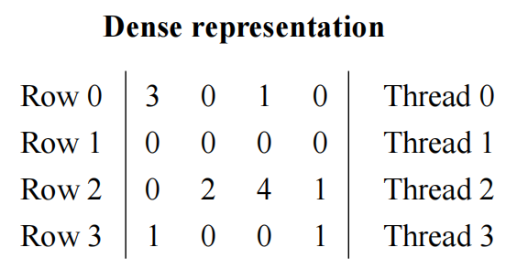
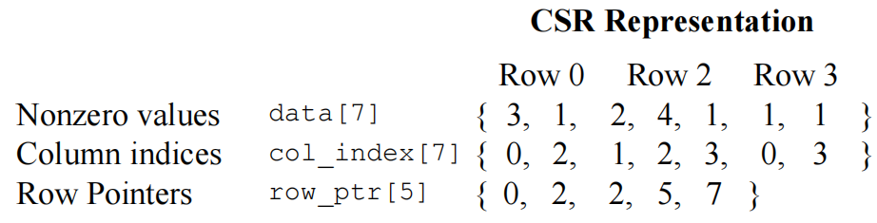
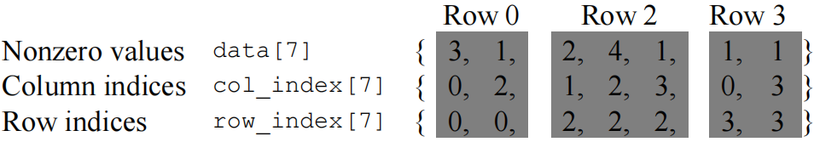
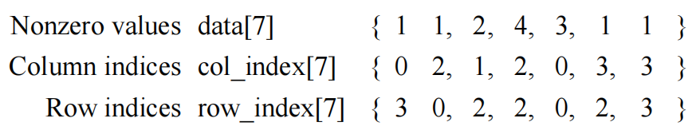
Sparse Matrix: CSR and COO
CSR: Compressed Sparse Row
CSR is not memory coalecsed, while ELL is.
COO *** Allows reordering ***
COO is storing a bit more things, but every thread can take part in and atomically accumulate to output. Still not coalecsed unless arange the data properly, and atomic operation is needed.

Slide 6
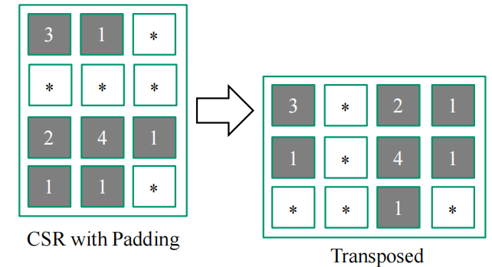
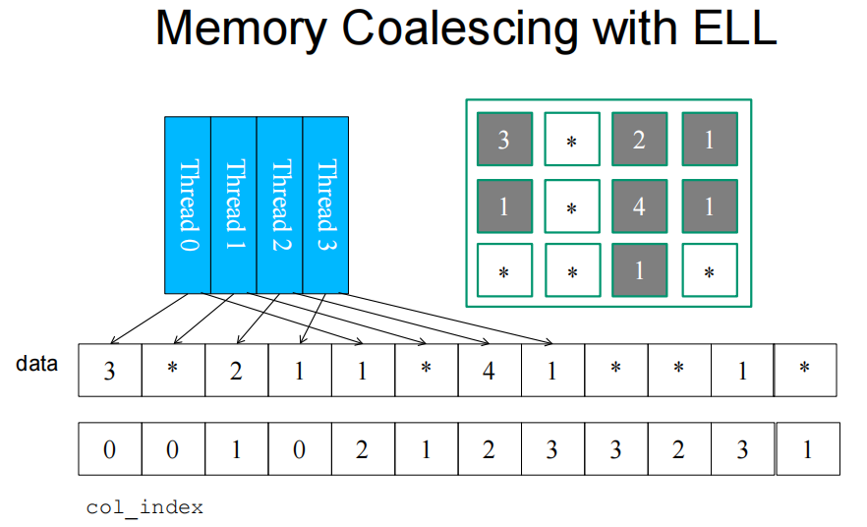
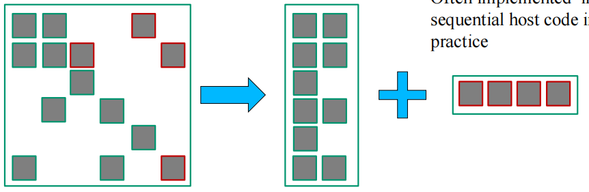
ELL+COO
ELL needs padding, so we need the rows to have approximately similar number of nonzero elements. COO can do the rest of the work since it allows reordering.

Slide 7
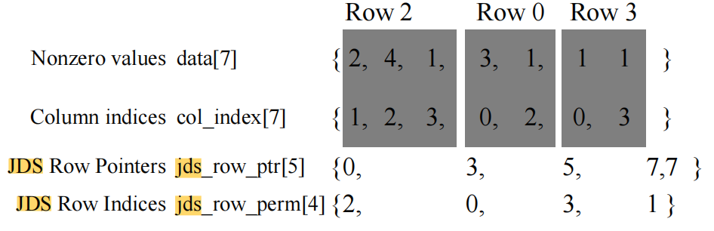
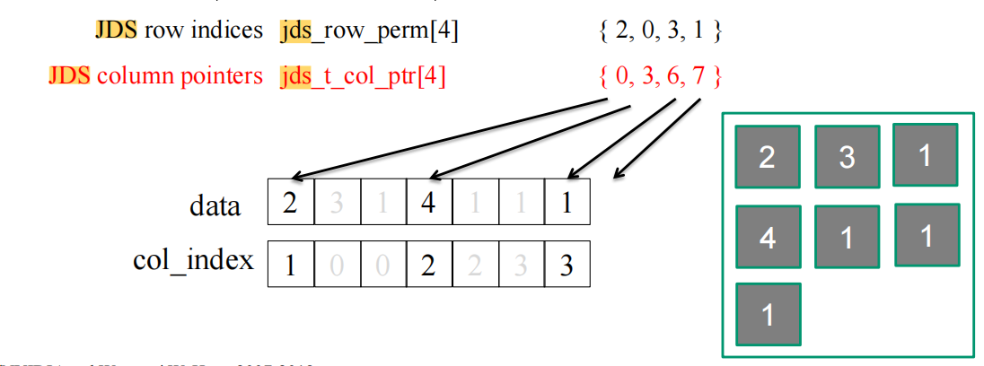
Sparse Matrix: JDS vs JDS_T
JDS: Sort rows into descending order according to number of non-zero,
JDS_T:
JDS Pros & Cons: neighboring threads tend to execute similar number of iterations because of sorting, but Adjacent threads still access non-adjacent memory locations

Slide 8
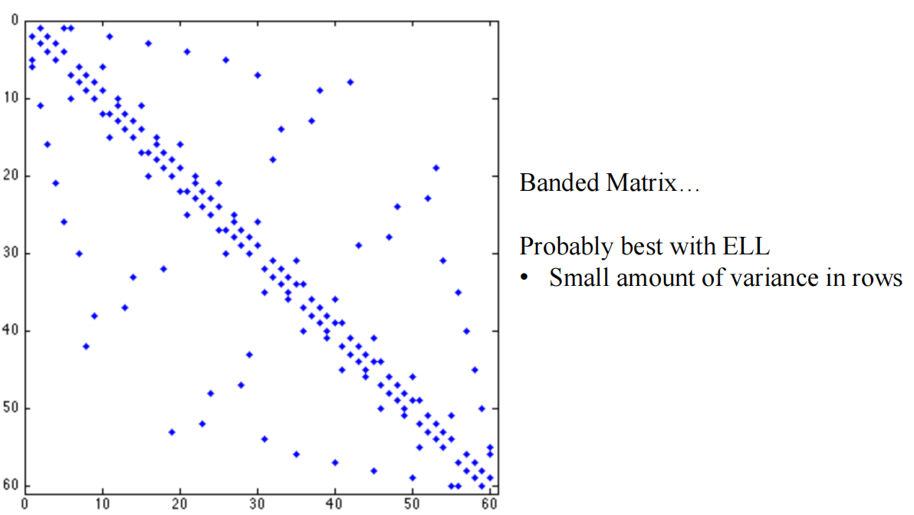
Summary
Very sparse: COO
Nearly Triangular: JDS
Banded matrix(small variance), Roughly random: ELL
High variance for each row: ELL+COO

Slide 9
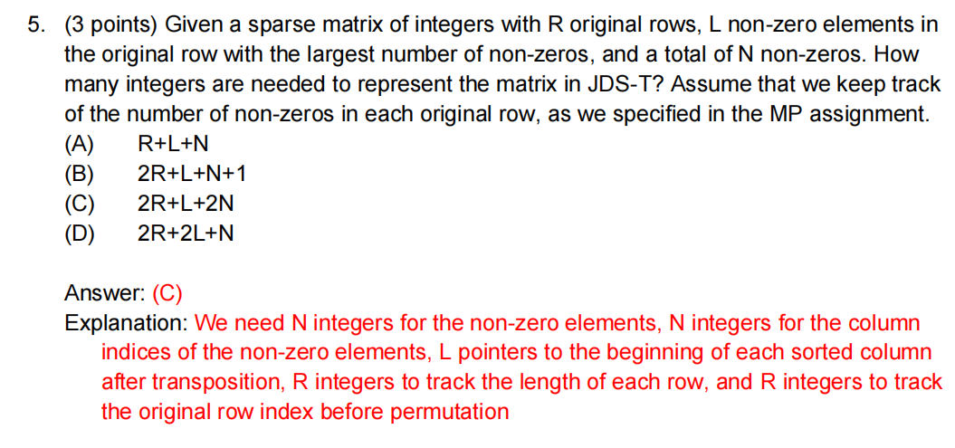
FA17

Slide 10
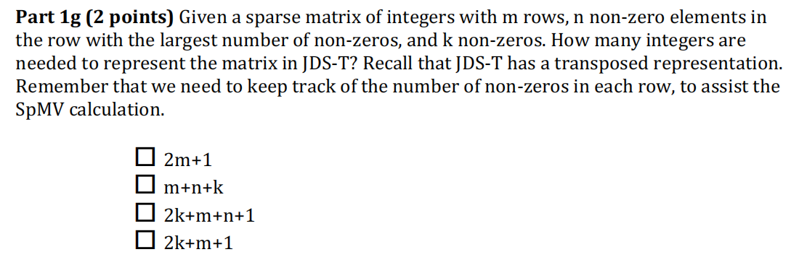

FA18

Slide 11
Additional Points:
ELL cannot represent alone (should with one additional parameter)
JDS_T: while or 'defined' for ? (usage of JDS_T Length of Cols matRows[4] )
Compressed Sparse Column (CSC): when to use over CSR?

Slide 12
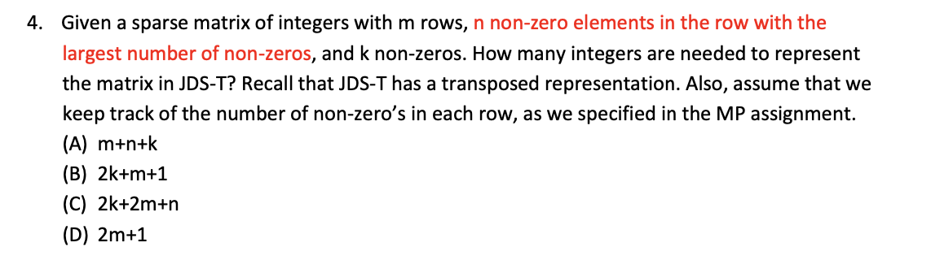
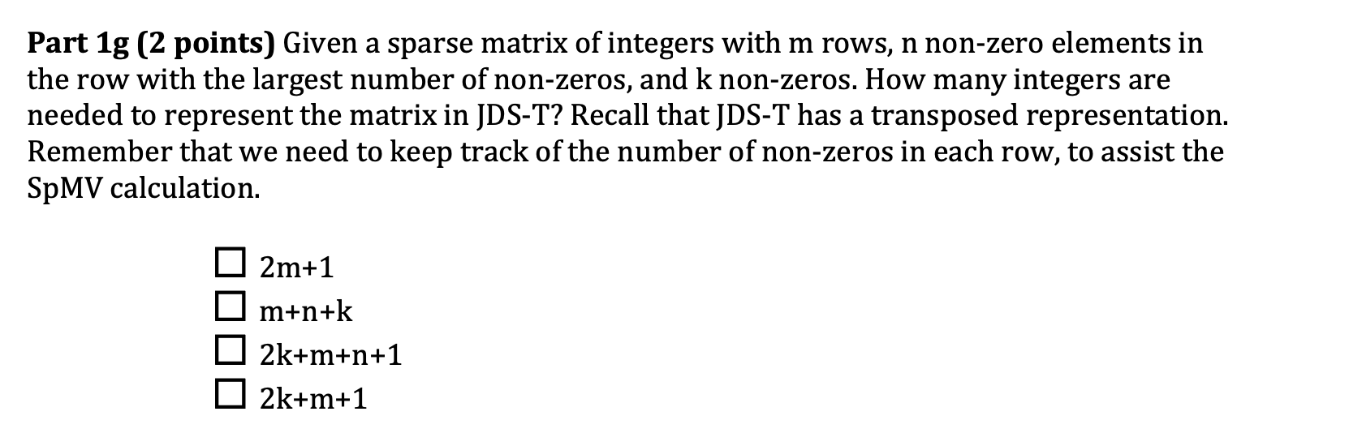
For while or For

Slide 13
Section5: Gpu&PC Arch
Calculation of PCIe Gen 2 and Gen 3 bandwidth given an X configuration 10/8 130/128 lane with 4 wire? Gen3 – 1GB/s
Understand the nature, use, and benefit of pinned (page-locked) memory
Understand the DMA used in CPU-GPU data transfers

Slide 14
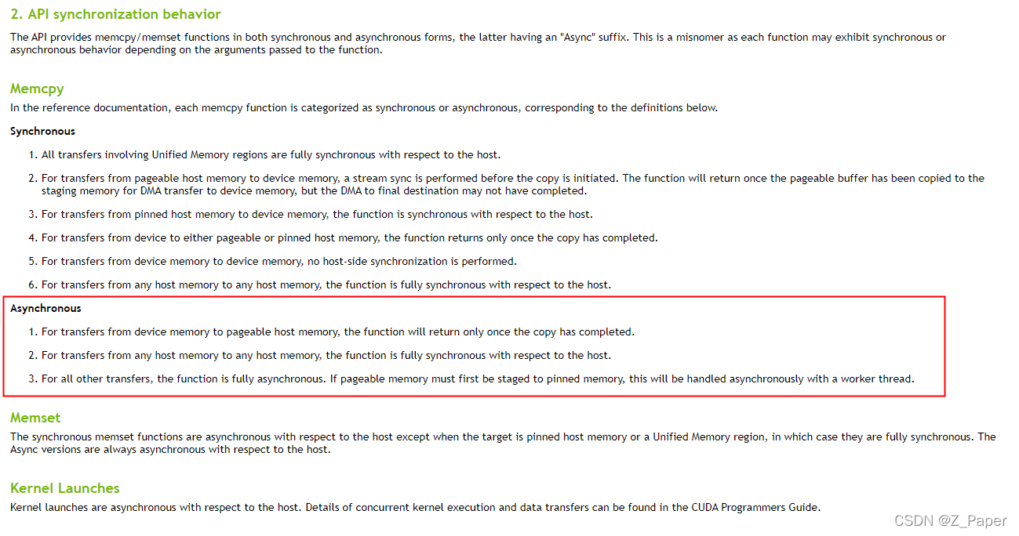

Slide 15
Section6: TC & Stream
TC(tensor core): bried review..... not likely be in the exam...
Stream: a higher level on PCIe
Stream(if not understand, view the slides...)

Slide 16
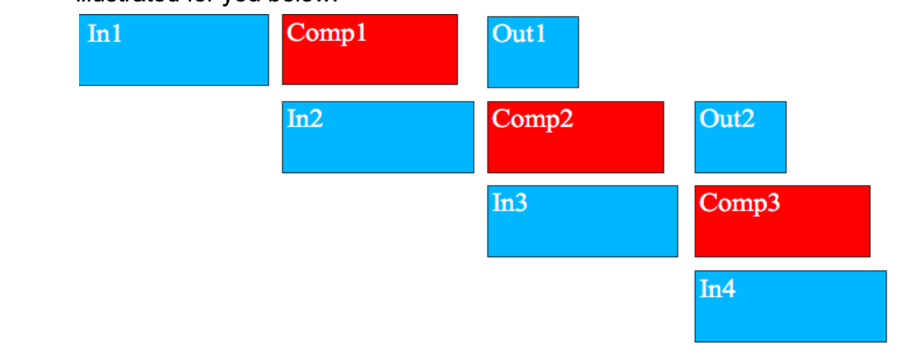
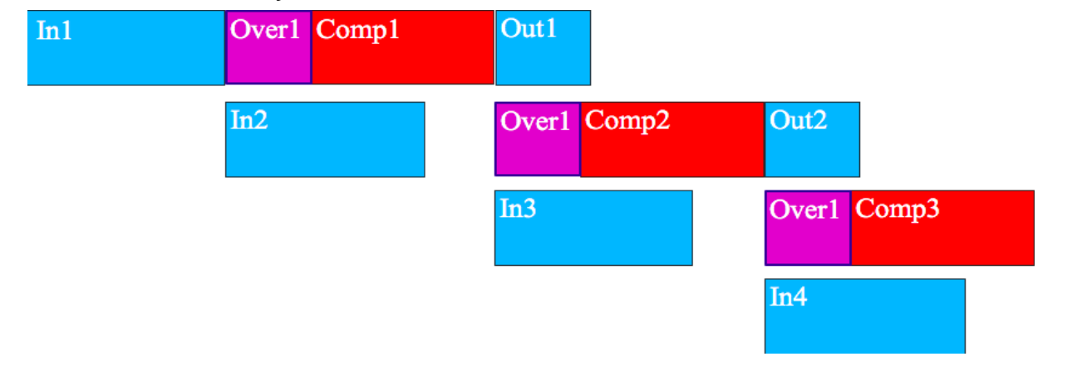
3 stream

Slide 17
Section7: Other CUDA-like frame & guest Lec
OpenACC
MPI+CUDA
------------
The basic API functions of MPI, especially MPI_Send and MPI_Receive
What are the meanings of MPI Ranks
How do the MPI processes specialize themselves after they enter main() function.
Guset lec: know the general concepts...

Slide 18
Section8: final Retrospective—how to define performance, and some other metrics
Final slides: if time is enough, recommand to go through

Slide 19
Labs & Codes...
Complex ones, need to review and clearly understand...
***Project's framwork & the Unroll & JDS_T so on
** Scan & Reduction: how to reduce the divergence & bulk situation
* atomic op
* record down the func: like MPI, OpenACC, and CUDA...
synchronization : important and esay to be forgot

